Slide 1
Career development in visceral surgery - EXPECTATIONS OF RESIDENTS
Oliver M. Fisher
SGC Kongress 2012
Hauptsitzung SGVC

Slide 2
Today‘s Topics
Defining Career Development
Career Development in Surgery
Expectations of Residents
Postgraduate Training in Switzerland
Postgraduate Specialization

Slide 3
Career Development

Slide 4
Defining Career Development
Longterm Career Goal
Job Opportunity
Skills Development
Establish Responsabilities
Defining Specific Short Term Goals
Reflection / Evaluation
Personal Goals / Family

Slide 5
Defining Career Development
Retaining Employees
Written list of milestones
Planned sequence of steps
Eligibility criteria
Personal strengths & potential
Assisting employees
Increases Attractiveness of Job
Just a plan, no contract!
Notes:
Ultimately, the purpose of a Career Development Plan is to assist employees in achieving their goals. In doing so, an organization also increases the likelihood of retaining employees, because employees recognize that managers have helped employees achieve their career goals within the organization, rather than employees believing they need to leave to pursue these goals somewhere else.
Written list of short / long-term goals
Planned sequence of formal / informal steps required
Assisting employees in achieving their goals
Goals linked to personal strengths & potential

Slide 6
Career Development in Surgery?
I am a surgeon
Residency Job Opportunity?
Learn How To Treat Patients
Operative Skill Development
Postgraduate Training
Reflection / Evaluation
Specialty
Personal Goals / Family

Slide 7
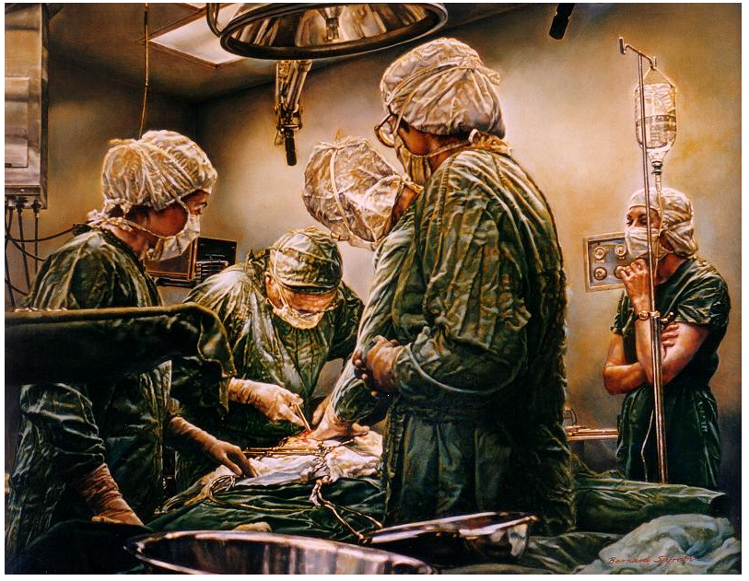
The Modern Surgeon?
Perfect knowledge
Perfect skill
Perfect academic
Perfect administrator
Perfect team-player
Perfect boss
Perfect parent
Perfect friend
Perfect golf-player

Slide 8
Expectations of Residents

Slide 9
Expectations of residents ???
Internet based survey
Successful „Basisexamen“ 2010/2011
221 residents
Response rate 41.6% (n= 92)

Slide 10
Long Term Career Goal
Am I „only“ a surgeon?
I am a surgeon!

Slide 11
Specialties
Notes:
General & Trauma Surgeon
Visceral Surgeon
Thoracic Surgeon
Vascular Surgeon
...don‘t know yet...

Slide 12
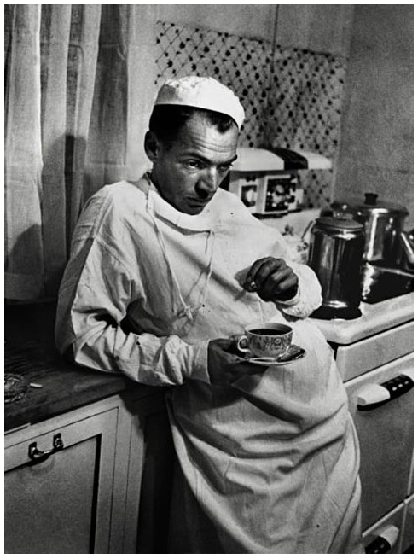
Long Term Goals
Notes:
A:11 5 = 16
H: 18, 21 = 39
P:3, 5 = 8
D:2, 23 = 25

Slide 13
Job Opportunities

Slide 14
Job Opportunities Switzerland 2011
No objective criteria
Only 20% offer full spectrum of modern surgery
12 V1 hospitals!
97 hospitals
20% „big“ (Cat. A & U)
80% „small“ (Cat. B3-B1)
Start big, go small?
vs.
Start small, go big?
http://www.fmh.ch/bildung-siwf/weiterbildung_allgemein/aerztedemographie.html
Notes:
530 = surgical candidates
Surgical positions – visceral chirurgie....

Slide 15
Postgraduate Training

Slide 16
Short Term Goals
Treat patients
Operative skills development
Think independently
Take responsibility

Slide 17
Are you being trained adequately?
52% = Year 3 & 4
Notes:
XX % im 3. und 4. Jahr

Slide 18
Do we need to reform our curriculum?
52% = Year 3 & 4
Notes:
Y: 22, 46 = 68
N: 4, 11 = 15
1: 1, 0
2: 9, 5
3: 20, 6
4: 18, 4
5: 9, 6
6: 2, 4
>6: 3, 5
26 + 22 = 48 -> 48/91 = 52% der Befragten sind Jahr 3&4

Slide 19
How?

Slide 20
More Structured?
Notes:
Y: 50, 25
N: 5, 1

Slide 21
More Structured – Why?

Slide 22
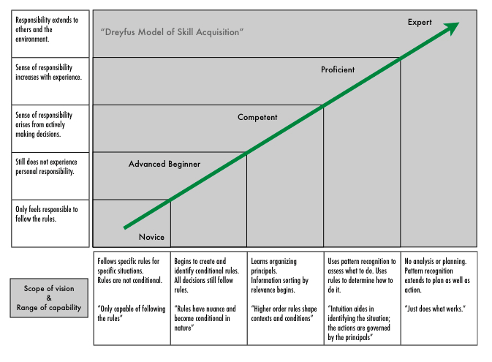
More Structured – Why?
10‘000h
Board Exam
Operative skill is learned, not innate!
Bell RH, Surgery, 2009
Notes:
The 10.000 hour rule – Dr. K. Anders Ericsson = cognitive psychologist from Florida State University
10.000h = 8h /d of EXPLICIT training!!! For 5y
5h/d = 25h/w = 400wo = 7.6y (8 years...)
Roger Federer 10.000h auf dem Platz, nicht 10.000h John McEnroe zuschauen

Slide 23
More Structured – How?
Strict curriculum, structured by years
Annual OR-Log
Designated Program Directors
Regular evaluations
Trainee contracts
Regulation (SIWF)
Centralization with networks
Strict selection, but please train us!!

Slide 24
Earlier Specialization?
Notes:
Die frühere Spezialisierung ist ein heiss diskutiertes Thema, nicht weniger weil, die Meinung hierzu fast gleich gross sind, mit jedoch einer Mehrheit für eine frühere Spezialisierung. Insbesondere wenn man diese konkretisiert, im Sinne einer 4jährigen Grundausbildung mit anschliessendem Fokus auf den erwünschten Schwerpunktstitel, sind die Assistenten mehrheitflich für eine frühere Spezialisierung. Wenn gefragt, so äussern die AA, dass ihre Hauptsorge ist, dass man zu spezialisiert sein könnte am Ende einer solchen Ausbildung. Es stellen aber über die Hälfte der Befragten fest, dass es heutzutage eine Realität sei, dass man sich nicht mehr auf 1-2 Gebiete der Viszeralchirurgie fokussieren kann, um als wahrer Fachexperte zu gelten.

Slide 25
Benefits of early differentiation?

Slide 26
Benefits of early differentiation
Improved continuity
Improved case distribution
Improved intraoperative experience
Improved assessment
Education shift back to residency
Board exam = competency/proficiency
Increased satisfaction, less drop-outs
Improved attractiveness of surgical career?
Moalem & Schwartz, J Surg Educ, 2012

Slide 27
Downsides of Early Differentiation?

Slide 28
More?

Slide 29
Fellowships in Switzerland?

Slide 30
Current Trends in Subspecialties
20% „big“
80% „small“
12 V1
Notes:
SO: 3, 14
Trans: 1, 3
HPB: 6, 9
CR: 11, 16
UGI: 1, 7
DK: 8, 21

Slide 31
Other advantages?

Slide 32
Gender Demographics in Medicine (1986 – 2011)
in percent
-- Female
-- Male

Slide 33
Gender Demographics: Board Exam
All specialties
Surgery
Working Full-Time: 13%!!!!
≈ 50% women
≈ 25% women
http://www.fmh.ch/bildung-siwf/weiterbildung_allgemein/aerztedemographie.html

Slide 34
Does specialization help combine family and work?
Notes:
Y: 32 + 9 = 41
N: 25 + 17 = 42

Slide 35
Career Development in Visceral Surgery Expectations of Residents

Slide 36
Expectations of Residents
Career Development Plan
Visceral surgery favoured, but little exposure
Early differentiation / specialization
Fellowships in Switzerland
Stringent & adaptive curriculum
Enhance female percentage

Slide 37
Expectations of residents ???
Thank you for listening!

Slide 38
Defining Career Development
Definition of milestones
Definition of eligibility criteria
“just a plan”, no contract
Increases Attractiveness of Job
Notes:
Note, too, that Career Development Plans are just plans; they do not represent career commitments to the employee nor the Manager or Supervisor.

Slide 39
Work Abroad?
Non-Academics > Academics

Slide 40
Why Work Abroad?

Slide 41
Subspecialties
Notes:
So a majority of residents aim at achieving a form of specialty during their career. And the majority of residents want to leave Switzerland to training outside of the country because they say the curriculum offers more.

Slide 42
Over-Specialization vs. Countries Needs
XX% concerned about over-specialization
XX% see subspecialization as modern reality

Slide 44
Six years and I still don‘t know what I‘m doing...

Slide 45
How?

Slide 46
Job Opportunities Switzerland 2011
http://www.fmh.ch/bildung-siwf/weiterbildung_allgemein/aerztedemographie.html

Slide 47
Job Opportunites Switzerland 2011
http://www.fmh.ch/bildung-siwf/weiterbildung_allgemein/aerztedemographie.html
Notes:
1% = 13 Stellen!!!!

Slide 48
Job Opportunites Switzerland 2011
http://www.fmh.ch/bildung-siwf/weiterbildung_allgemein/aerztedemographie.html
Notes:
21 Teilzeitstellen

Slide 49
Women In Surgery

Slide 50
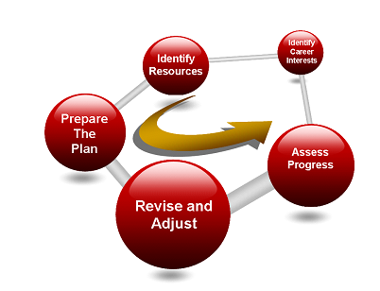
Career Development Plan
Individual meeting with employee
Identify short/long-term goals
Establish interests
Identify resources
Prepare the plan, revise and adjust it with your employee
Confirm alignment via signature
Assess progress against the plan at mid-year and year-end review
Trueba J, The Career Development Plan
Notes:
Here are some steps for supporting an effective development plan for your employees. Discussions and plans about development should focus on two dimensions: specific technical and functional expertise and overall demonstration, by the employee, of the organization's culture, philosophy and values.
Meet individually with your employees to identify their long-term career interests. It should be based on their previous performance review, their objectives for the current performance period, and feedback provided to you throughout the year. Specifically, ask the employee to state goals for the short term (1-5 years) and long-term (+5 years). Also ask the employee about his or her current job: whether she or he is interested in receiving any special types of assignments, participating in any training courses, or contributing in new ways to the department. Record the information.
After the meeting, identify resources within your organization that can help the employee achieve his or her goals. Also consider helpful resources outside of the organization.
Formal training within the organization
Mentoring
Local assignments
Books, manuals, other print and electronic media
External education (e.g. university courses) Discuss with the employee any resources that may help implement the plan and meet defined goals. Resources may include other people who could monitor progress and/or provide ongoing feedback; customers; other supervisors' feedback; and financial support to attend training or educational courses.
Prepare the plan. A development plan should be used throughout the year to note the employee's completed activities and follow-up activities. In addition, add his/her development goals to the overall objective-setting plan for the year.
Meet in-person with the employee to review the proposed plan, and based on feedback, revise it, adjust it and confirm alignment by providing your signature and obtaining the employee's signature. If appropriate, file the ICDP form in the employee's personnel file. Make certain you keep a copy of the Plan and also make certain your employee keeps a copy. This will help focus your future meetings with each employee.
At the mid-year review and year-end performance review, meet with the employee to assess progress against the plan, changes in career goals (if appropriate), and revise the plan to adjust it, if necessary.

Slide 51
Career Development in Surgery?
I am a surgeon
Residency Job Opportunity?
Learn How To Treat Patients
Operative Skills Development
Postgraduate Training
Reflection / Evaluation
Specialty
Personal Goals / Family

Slide 52
Residency Job Opportunities in Switzerland
97 hospitals
20% „big“ (Cat. A & U)
80% „small“ (Cat. B3-B1)
Start big, go small?
Wait and see...
Only 20% offer full spectrum of modern surgery
Notes:
5 Unikliniken
17 Kat A
20 B3
34 B2
21 B1
Start big go small vs. Small go big?
Wait and see....

Slide 53
Job Opportunities Switzerland 2011
97 hospitals
20% „big“ (Cat. A & U)
80% „small“ (Cat. B3-B1)
No objective criteria
Blind applications
Only 20% of hospitals offer full spectrum of modern surgery
Only 12 V1 hospitals!
Start big, go small?
vs.
Start small, go big?
http://www.fmh.ch/bildung-siwf/weiterbildung_allgemein/aerztedemographie.html
Notes:
530 = surgical candidates
Surgical positions – visceral chirurgie....

